Slide 1
Activity Metrics Under Academic Pressure
Arda Cabaroglu 32270

Slide 2
Motivation
For this project, I explored how different aspects of my physical activity levels, such as daily active calorie expenditure, floors climbed and step counts, change based on my academic workload.
I analyzed the available health data of mine from previous semesters, including midterm and final exam weeks, to identify patterns and understand the impact of school work on my activity levels.

Slide 3
My Dataset
I will use data collected from my Apple Watch (health data), focusing on:
Active Energy: Calories burned through physical activities like walking, exercising (intentional phyical activity)
Step Counts: Daily step counts
Floors Climbed: Data on number of floors climbed

Slide 4
Steps of my project
1) Export the data from health app.
2) Use Beautiful Soup to read XML file
3) Use Pandas to clean and organize the data
4) Visualization
5) Statistical Analysis

Slide 5
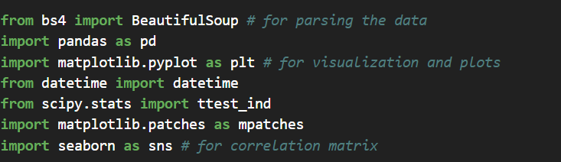
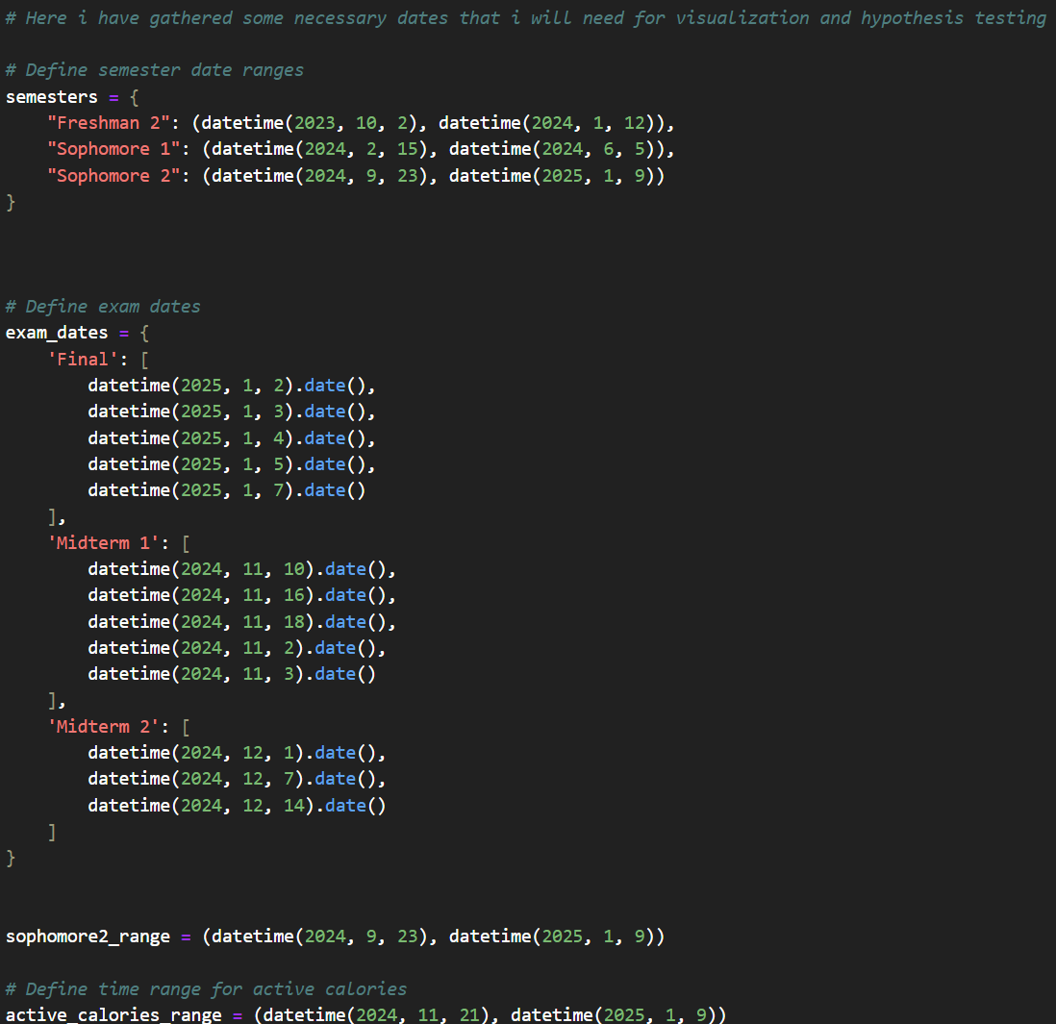
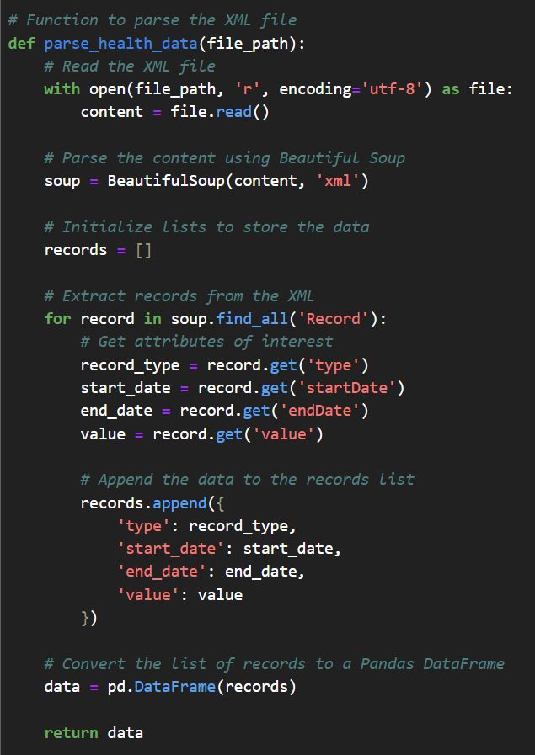
Importing necessary libraries
I also gathered certain time intervals/dates which could be useful
Parsing and organizing the imported XML file
Step 4: Visualization ->>

Slide 6

DATA VISUALIZATION
To analyze and present the data, I employed Exploratory Data Analysis (EDA) techniques. The visualizations provided insights into trends and patterns across various metrics. Key visualization tools and methods used include:
Pie Charts: For comparing proportions, such as activity levels on specific days versus regular days.
Bar Charts: To illustrate trends across semesters or other time periods.
Histograms: For showing the distribution of activity data like steps or calories burned.
Correlation Matrices: To explore relationships between multiple variables, such as step counts, floors climbed, and active energy.
These visualizations were critical in identifying meaningful patterns and understanding how academic workload influenced physical activity levels.

Slide 7
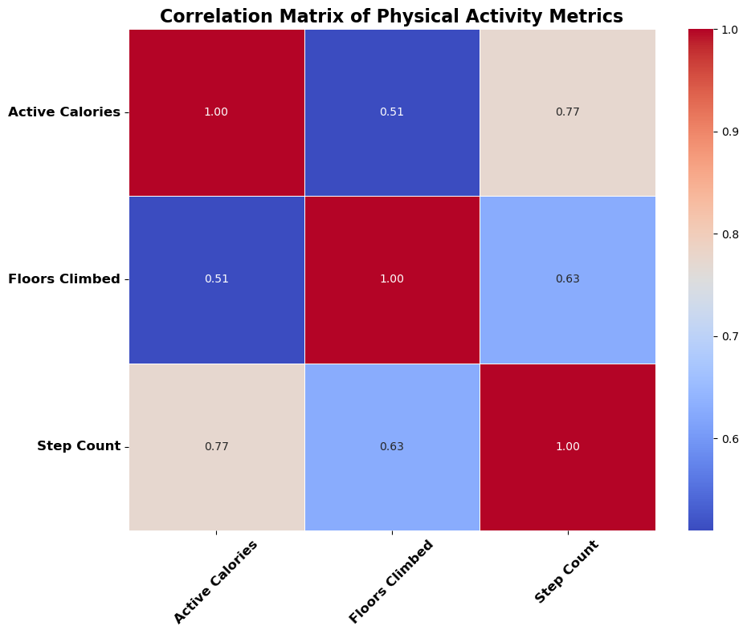
Understanding the Correlation Between Metrics
The correlation matrix shows how different activity metrics relate to each other based on my data:
Step Count and Active Calories have the strongest positive link (0.77), which makes sense as more steps usually mean more calories burned.
Floors Climbed also connects positively with Step Count (0.63) and Active Calories (0.51), showing a moderate relationship.
What This Means: Steps and active calories are closely tied together, so step count can be a good indicator of overall activity. This will help us see how activity changes with more schoolwork.

Slide 8
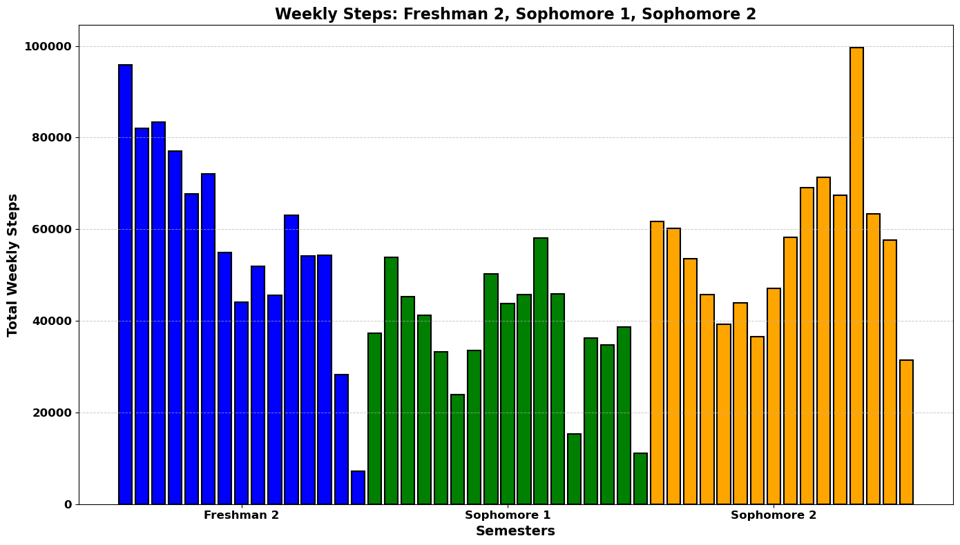
To start with average steps made per week across all semesters,
We can see that step count averages get lower towards the end of each semster. (that is when we have our final exams.)

Slide 9
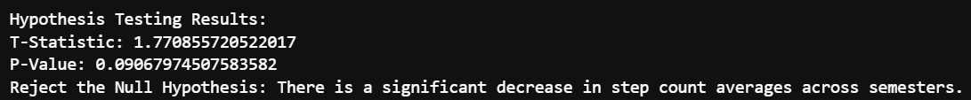
Hypothesis
Null Hypothesis (H₀): There is no significant decrease in step count averages across semesters.
Alternative Hypothesis (H₁): There is a significant decrease in step count averages across semesters due to increasing academic workload.
Considering the level of significance as 0.10, using T-test method, here is the result.

Slide 10
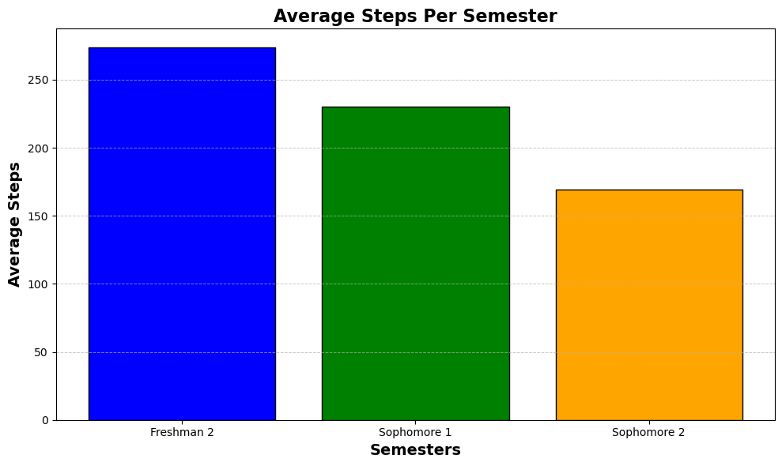
We are able to clearly see that average steps per semester gets lower as the academic work load increase.

Slide 11
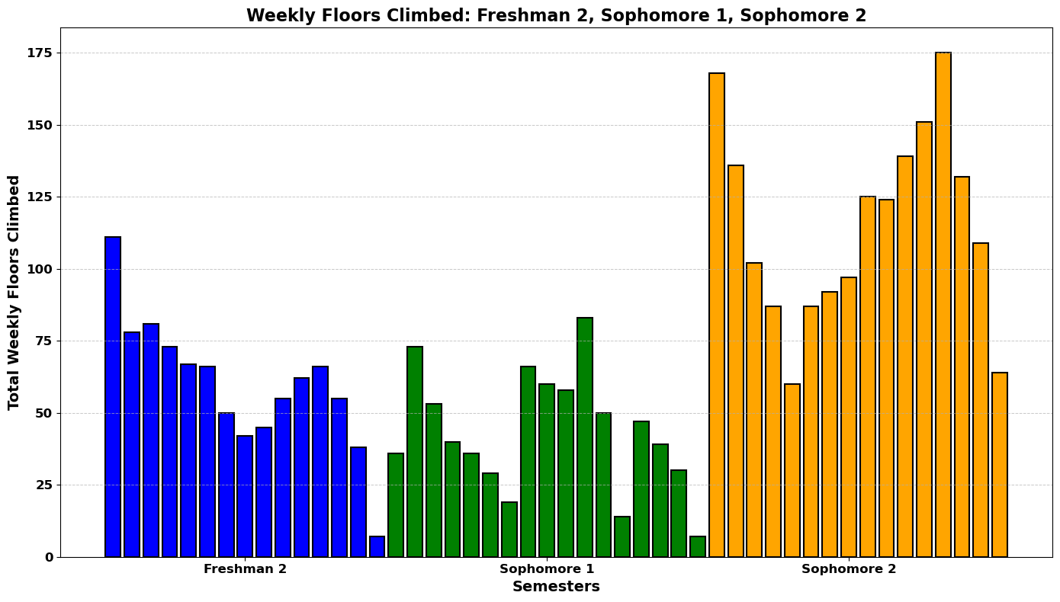
Looking at the floors climbed data, there seems to be no trend/relation. This is expected since it mostly depends on which level my dorm room is located for that semester.
sophmore 1: 0th floor, sophmore 2: 3rd floor
It does not seem to reflect any study habits.

Slide 12
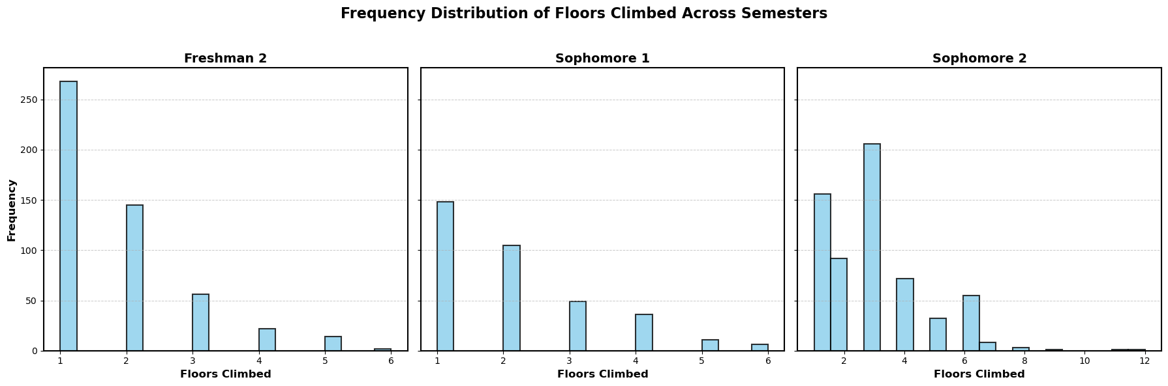

Slide 13
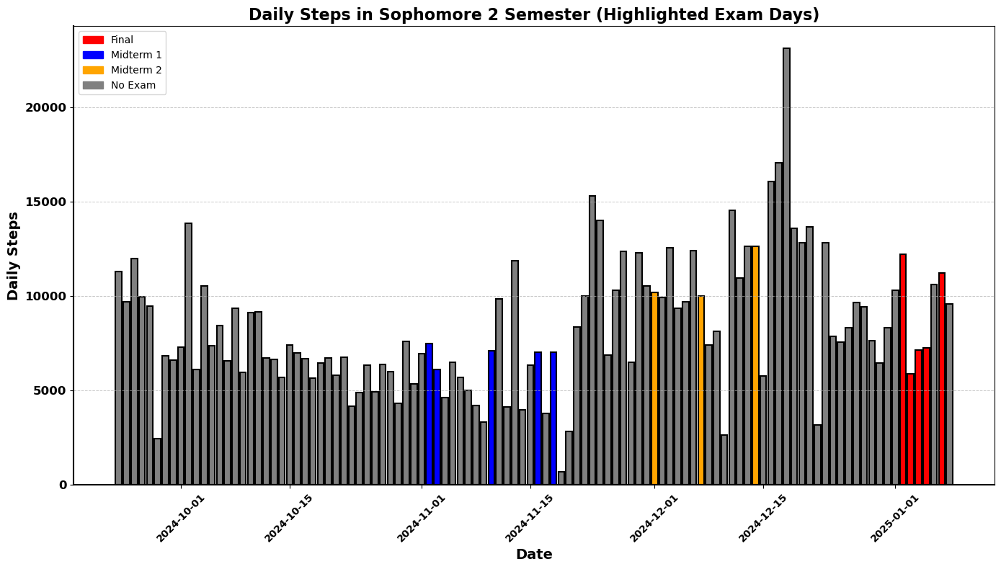
This chart highlights the daily steps recorded throughout the Sophomore 2 semester, with exam days distinctly marked.
Despite marking these examination days, the data does not show a clear or consistent trend in daily step counts corresponding to these events.

Slide 14
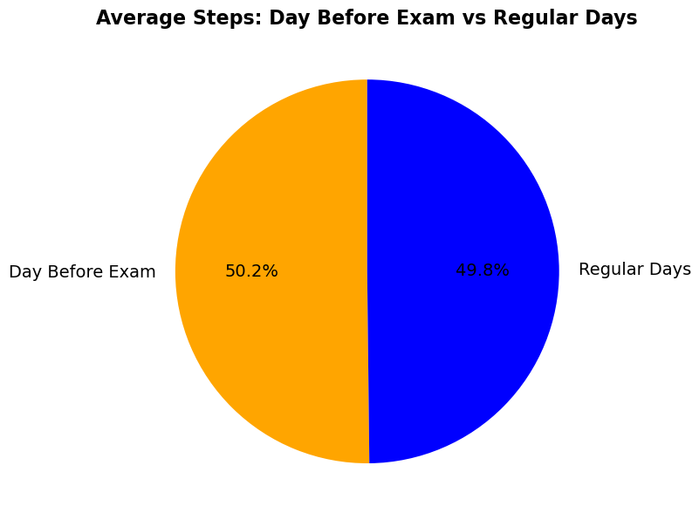
To explore further, I analyzed the average steps taken on the days before exams and compared these with the average steps on regular days.
Surprisingly, the results show nearly equal distribution, with 50.2% of steps taken on the day before exams and 49.8% on regular days.

Slide 15
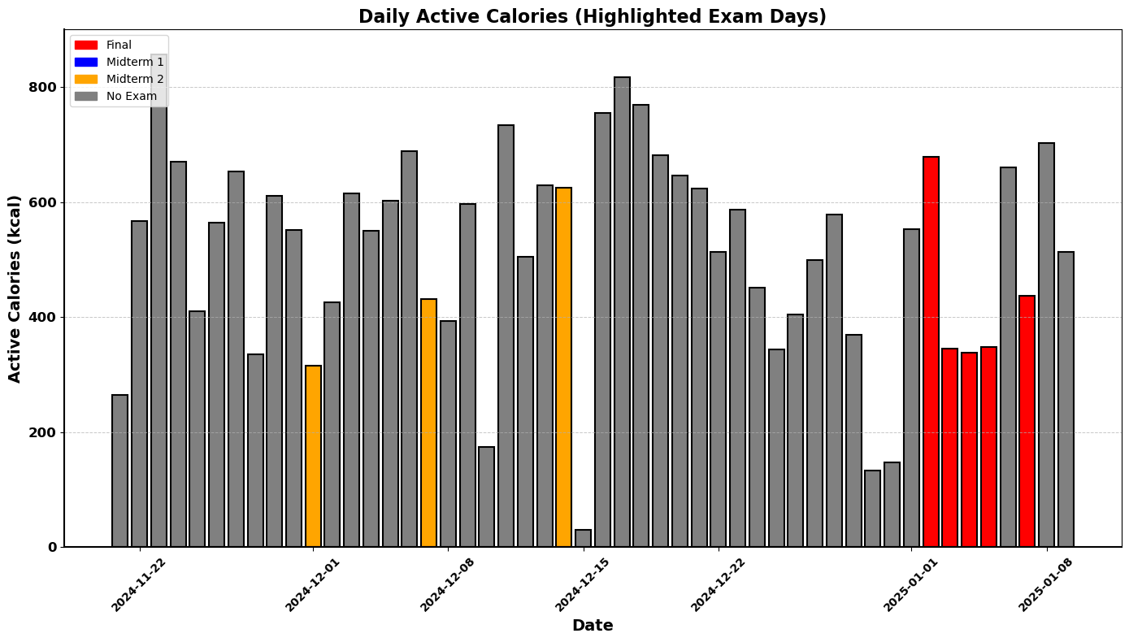
Looking at the active calorie data (missing data points were filled with the mean), still cant see something solid.
Lets run a test!

Slide 16
Hypothesis
Null Hypothesis (H₀): No significant difference in active calories on exam/midterm days and regular days.
Alternative Hypothesis (H₁): Active calories are significantly lower on exam/midterm days.
Considering the level of significance as 0.10, Conclusion of T test:

Slide 17
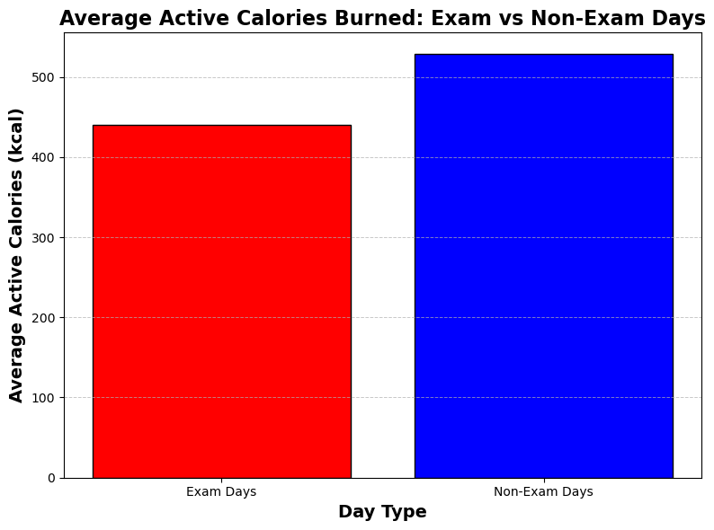

"We observed that the average active calories burned on exam days (439.78 kcal) are slightly lower compared to non-exam days (528.69 kcal), as expected. However, the difference was not statistically significant, and the Null Hypothesis could not be rejected. This suggests that exam days may not drastically impact active calorie expenditure, but other factors might also play a role."

Slide 18
My Findings
Floor Counts:
No observable relationship between floor counts and academic workload.
The variations were primarily influenced by the location of my dorm room:
Sophomore 1: Dorm room on the 0th floor.
Sophomore 2: Dorm room on the 3rd floor.
This metric did not provide insights into study or physical activity patterns.
Average Steps:
There is a noticeable decrease in average steps per semester as academic workload increased.
This trend highlights the potential impact of academic stress and time constraints on physical activity.
Active Calorie Expenditure:
The average active calories burned on exam days were slightly lower compared to non-exam days.
However, the difference was not statistically significant, indicating that other factors may influence calorie expenditure more than exams alone.

Slide 19
Limitations
Short Active Calorie Data Duration: The active calorie data available for analysis was limited to the current semester. Unfortunately, I did not have data from previous semesters to compare trends over a longer period.
There were also some missing data points, however they were filled with the average.

Slide 20
Future Work
Collecting More Data: Over the next semesters, I plan to collect a more comprehensive dataset that includes active calorie records over a longer timeline. This will allow for better comparisons and trend analysis.
Enhancing Hypothesis Testing: With a larger dataset, I will perform more detailed hypothesis tests to better understand the effects of academic workload on physical activity levels.
Using Machine Learning Models: In the future, I plan to use machine learning techniques, like regression models, to predict metrics like active calories or step counts for upcoming semesters.

